Slide 1

Social Media
-and-
Narcotics Anonymous

Slide 2
First, some history…
“AA’s relevance to the development of Narcotics Anonymous has never been in question. It is commonly conceded that without Alcoholics Anonymous, there would be no Narcotics Anonymous. In fact, our earliest literature states: “Our precepts are patterned after those of Alcoholics Anonymous, to which all credit is given and precedence is acknowledged.”
(Narcotics Anonymous World Services, 1998, pg. 16)

Slide 3
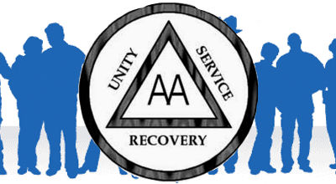
Alcoholics Anonymous
Our predecessor, the Alcoholics Anonymous program was founded on June 10th, 1935.
Due to a rapidly growing fellowship, in 1941 Alcoholics Anonymous faced the harsh reality that they needed to unify their groups or they would perish.

Slide 4

Some of the struggles that they faced were a lack of communication and organization.
Arguments were had over membership, leadership, money, power, and prestige.

Slide 5

How did they handle this?
After much discussion, the AA fellowship created the Twelve Traditions. By 1955 they were included into the 2nd edition of their main text, Alcoholics Anonymous (The Big Book).

Slide 6
Narcotics Anonymous
Even though there existed a fellowship for those afflicted by alcoholism, recovery had not become available for drug addicts until 1950.
The first Narcotics Anonymous meeting was held in New York City.

Slide 7
These meetings had a loose adaptation of the steps and did not practice any Traditions or guidelines.
During this period of much trial and error, NA meetings started and failed multiple times.

Slide 8
Narcotics Anonymous, as we know it, can be attributed to a man named Jimmy K. who brought NA meetings back to life in southern California in 1959.
Jimmy K. felt it had become apparent that our fellowship would not succeed without the guiding principles of the Twelve Traditions.

Slide 9

Jimmy K. is not only responsible for encouraging the use of the Twelve Traditions in Narcotics Anonymous (as adapted from Alcoholics Anonymous), but he is also one of a handful of early members who wrote much of the literature we use today.

Slide 10

Why does this matter?

Slide 11
The Twelve Traditions
The Twelve Traditions were written before an era of social media.
History clearly shows that our fellowship would perish without them.
However, is it possible to use the Traditions to guide our service… even in the digital realm?

Slide 12
The Answer is YES!!
As the world had changed around us, so has our program changed by developing principles and guidelines to address the growing use of social media in today’s society.
Luckily, the Twelve Traditions were written with enough flexibility to allow for broad interpretation across multiple forms of media.

Slide 13


Slide 14
“Our goal is not to endorse or encourage the use of social media or any particular social networking resource; we are simply responding to the reality that many members do utilize these resources and also to the many requests for guidance and insight on how to use social media responsibly in light of our tradition of anonymity.”
(Narcotics Anonymous World Services, 2011, pg. 1)

Slide 15
“Our common welfare should come first; personal recovery depends on NA unity.”
“Unity is a must in Narcotics Anonymous. This is not to say that we do not have our disagreements and conflicts; we do. Whenever people get together there will be differences of opinions. However, we can disagree without being disagreeable. Time and time again, in crises we have set aside our differences and worked for the common good.”
(NAWS, Inc., 2010, pg. 63)

Slide 16

“We must live and work together as a group to ensure that in a storm our ship does not sink and our members do not perish.”
(NAWS, Inc., 2010, pg. 63)

Slide 17
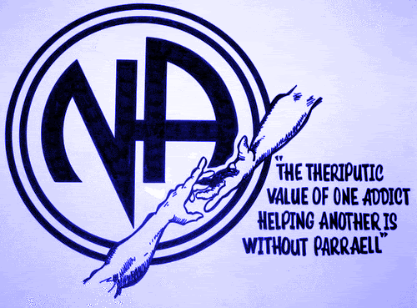
5. “Each group has but one primary purpose--to carry the message to the addict who still suffers.”

Slide 18
“What would happen if our groups had another primary purpose? We feel our message would be diluted and then lost.”
“If our group purpose were anything other than to carry the message, many would die and few would find recovery.”
(Both from NAWS, Inc., 2010, pg. 68)

Slide 19

6. An NA Group ought never endorse, finance or lend the NA name to any related facility or outside enterprise, lest problems of money, property or prestige divert us from our primary purpose.

Slide 20

“To endorse is to sanction, approve, or recommend. Endorsements can be either direct, or implied. We see direct endorsements every day in television commercials. An implied endorsement is one that is not specifically stated.” (NAWS, Inc., 2010, pg. 69)

Slide 21
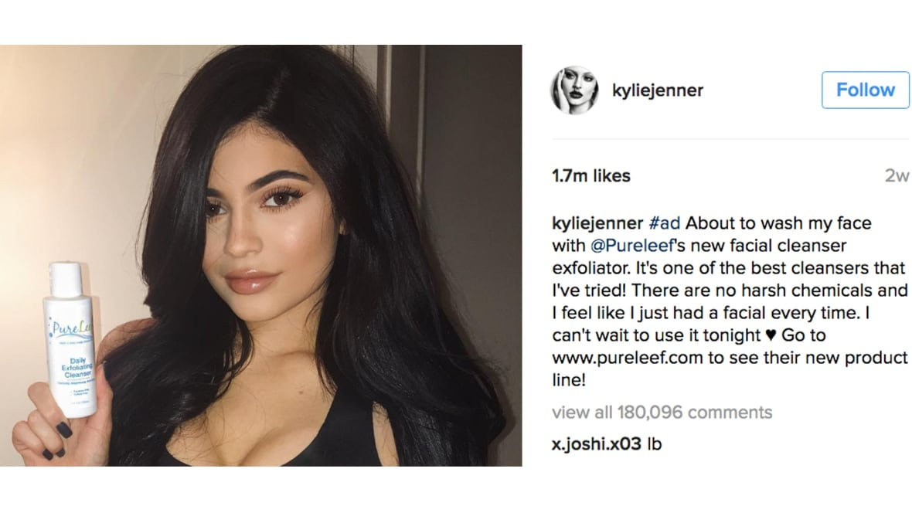

Slide 22
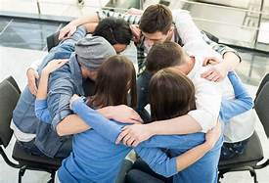
“Narcotics Anonymous is a distinct and separate fellowship in its own right. Our problem is addiction. The other twelve step fellowships specialize in other problems, and our relationship with them is one of cooperation, not affiliation.” (NAWS, Inc., 2010, pg. 70)

Slide 23

“The Sixth Tradition goes on to warn us what may happen: "lest problems of money, property or prestige divert us from our primary purpose. These problems often become obsessions and shut us off from our spiritual aim. For the individual, this type of abuse can be devastating; for the group it can be disastrous.”
(NAWS, Inc., 2010, pg. 70)

Slide 24

10. “NA has no opinion on outside issues; hence, the NA name ought never be drawn into public controversy.”

Slide 25
“We don’t take sides. We don’t have any recommendations. NA, as a fellowship does not participate in politics; to do so would invite controversy. It would jeopardize our fellowship. Those who would agree with our opinions might commend us for taking a stand , but some would always disagree. With a price this high, is it any wonder we choose not to take sides in society’s problems?”
(NAWS, Inc., 2010, pg. 74)

Slide 26
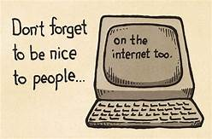
“Be thoughtful about the comments that you make on a NA member’s non-NA-related posts. Perhaps they structured a post to have no identifiable reference to NA and posted it widely to their friends, family, and co-workers. You should not then post an NA-related or addiction related comment under that post.”
(Narcotics Anonymous World Services, 2011, pg. 1)

Slide 27

Be mindful that your behavior is a reflection of Narcotics Anonymous. Be respectful of others. Anyone that your comments are shared with may be a current or future member of Narcotics Anonymous.

Slide 28
11. “Our public relations policy is based on attraction rather than promotion; we need always maintain personal anonymity at the level of press, radio, and films.”
Tradition Eleven is very important in the realm of social media.
Let’s break it down….

Slide 29
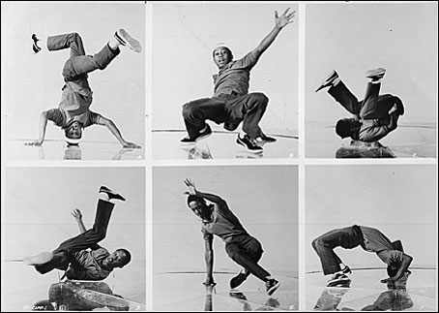

Slide 30


Slide 31

Our Public Relations Policy
“Our public image consists of what we have to offer, a successful proven way of maintaining a drug-free lifestyle.
(NAWS, Inc., 2010, pg. 75)

Slide 32

Attraction, Not Promotion
“Our attraction is that we are successes in our own right. As groups, we offer recovery. We have found that the success of our program speaks for itself; this is our promotion.
(NAWS, Inc., 2010, pg. 75)

Slide 33
Always Maintain Personal Anonymity
“A dictionary definition of Anonymity is “ a state of bearing no name.” In keeping with Tradition Twelve, the “I” becomes “we.” The spiritual foundation becomes more important than any one group or individual.”
“This is to protect the membership and the reputation of Narcotics Anonymous. We do not give last names nor appear in the media as a member of Narcotics Anonymous. No individual inside or outside the fellowship represents Narcotics Anonymous.”
(Both from NAWS, Inc., 2010, pg. 75)

Slide 34
At the level of press, radio, and films:
“If an addict has never heard of us , he cannot seek us out. If those who work with addicts are unaware of our existence, they cannot refer them to us. One of the most important things that we can do to further our primary purpose is to let people know who, what, and where we are.” (NAWS, Inc., 2010, pg. 75)
“This Tradition goes on to tell us that we need to maintain personal anonymity at the level of press, radio, and films.” (NAWS, Inc., 2010, pg. 74)

Slide 35
12. “Anonymity is the spiritual foundation of all our Traditions, ever reminding us to place principles before personalities.”
“As we find ourselves growing closer together, the awakening of humility occurs. Humility is a by-product that allows us to grow and develop in an atmosphere of freedom, and removes the fear of becoming known by our employers, families, or friends as addicts. Therefore, we attempt to rigorously adhere to the principle that “what is said in meetings stays in meetings.”
(NAWS, Inc., 2010, pg. 75-76)

Slide 36
“While we may disagree as individuals, the spiritual principle of anonymity makes us all equal as members of the group. No member is greater or lesser than any other member.”
“Anonymity is one of the basic elements of our recovery and it pervades our Traditions and our fellowship. It protects us from our own defects of character and renders personalities and their differences powerless.”
(NAWS, Inc., 2010, pg. 76)

Slide 37

Final Thoughts…

Slide 38
Protect Everyone’s Privacy:
Familiarize yourself with and utilize social media privacy settings.
Consider organizing social media contacts into groups or categories.
Be thoughtful about the posts, pictures, tagging, events, or comments you make online.

Slide 39
Consider labeling posts and photos in a generic way that doesn’t specifically imply NA content. (ex. “Last weekend in Minnesota”, instead of “Minnesota Narcotics Anonymous Convention”.)
Before posting photos of other members, ask permission from them to do so. Also, be mindful of what is happening in the background of your photos.
Remember that not everyone has the same privacy settings or the desire to be identified as an “NA member” online.

Slide 40
NA Copyright
“The guidelines for using NA’s trademarked logos and copyright material are set forth in the Fellowship Intellectual Property Trust (FIPT).”
“NA groups and registered NA service committees must follow certain rules when making use of NA’s trademarked logos, and those rules can be found in the NA Intellectual Property bulletin #1, Internal Use of NA’s Intellectual Property.”
(Narcotics Anonymous World Services, 2011, pg. 7-8)

Slide 41

“While motivations for using the NA name or trademark are usually positive, unfortunately it can often end up reflecting poorly on NA when individuals create pages, groups, or profiles using NA logos or trademarks, including sites that reprint NA literature in a manner that is not consistent with the rules spelled out in the FIPT.”
(Narcotics Anonymous World Services, 2011, pg. 8)

Slide 42
NA Literature on Social Media:
Social Media and Our Guiding Principles
Public Relations Basics
Public Relations Handbook
(Chapter Ten: “Internet Technology”)
These pieces of NA literature are available through our Area Literature Chairperson or online at naminnesota.org

Slide 43
Conclusion
“The widespread use of social networking and social media by our fellowship indicate that these forums are resources that can serve to facilitate greater communication and interactions among NA members. The ability to network with other recovering addicts and share in mutual support of one another’s recovery offers many members a way to enhance their relationship with the NA fellowship.”

Slide 44
“With NA’s public image and the anonymity and privacy of our members at stake, it is crucial that those of us who choose to use these resources take great care in doing so.”
(Narcotics Anonymous World Services, 2011, pg. 10)

Slide 45


Slide 46
Works Cited
Miracles Happen: The Birth of Narcotics Anonymous in Words and Pictures. Chatsworth, California: World Service Office
Social Media and Our Guiding Principles. Chatsworth, California: World Service Office
Narcotics Anonymous (Large Print). Chatsworth, California: World Service Office

