Slide 1
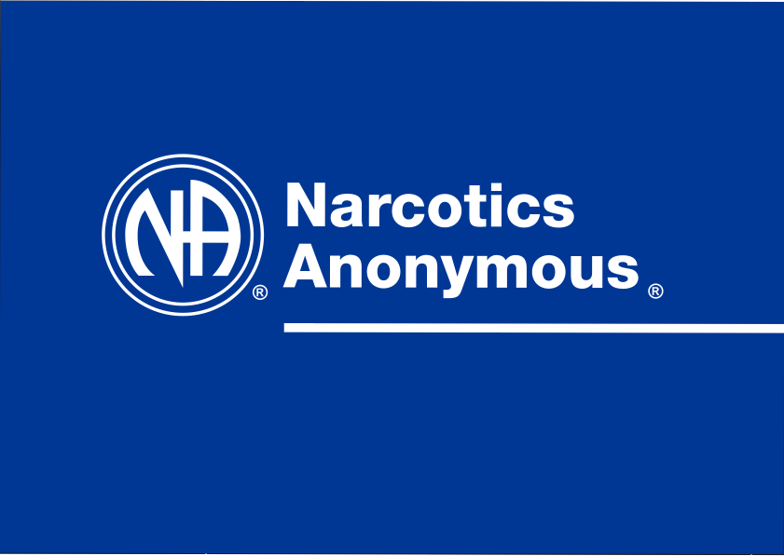
5
Notes:
Good Morning/Afternoon! Thank you for inviting us to speak to you today.
We are the Public Relations subcommittee for Narcotics Anonymous in this area.

Slide 2

Our Message
An addict, any addict, can stop using, lose the desire to use, and find a new way to live
Notes:
This is our message: An addict, any addict, can stop using, lose the desire to use, and find a new way to live. This is our entire message. Our message is all about freedom from active addiction.
As a fellowship we have one primary purpose, to carry our message to the addict who still suffers.

Slide 3
Presentation Goals
What Narcotics Anonymous is
What Narcotics Anonymous is not
What can be expected from meetings
Where our meetings take place
How we can be community partners in the recovery process
Resources
Notes:
Our overall goal in public relations is a simple one, communication and relationship-building in the recovery community at large, our goals for this presentation are the following, to discuss:
What Narcotics Anonymous is
What Narcotics Anonymous is not
What can be expected from meetings
How we can be community partners in the recovery process

Slide 4
What Narcotics Anonymous Is
NA is a nonprofit Fellowship or society of men and women for whom drugs had become a major problem.
12-Step recovery program of recovering addicts who meet regularly to help each other stay clean.
This is a program of complete abstinence from all drugs.
There is only one requirement for membership, the desire to stop using.
Notes:
NA is a nonprofit fellowship or society of men and women for whom drugs had become a major problem. We are recovering addicts who meet regularly to help each other stay clean. This is a program of complete abstinence from all drugs.
NA sprang from AA in the 1950’s; however, today we are two uniquely different fellowships: in Narcotics Anonymous we refer to ourselves as addicts and focus on the disease of addiction, not any one individual drug
As a fellowship we are not affiliated with any other organizations; nor are we not connected with any political, religious or law enforcement groups
In the world today there are more than 63,000 weekly meetings in over 130 countries and our literature has been translated into over 50 different languages
Narcotics Anonymous is entirely composed of recovering addicts; as such, we are not professionals and offer no professional services:
The Twelve Steps of Narcotics Anonymous as adapted from A.A. are the basis of our recovery program
Our identification as addicts is all-inclusive with respect to any mood-changing or mind-altering substances
Thus, ours is a program of complete abstinence from all drugs; however, we recognize that each person is responsible for their own medical well-being and that this must be determined between an individual and their doctor
There is only one requirement for membership, the desire to stop using

Slide 5
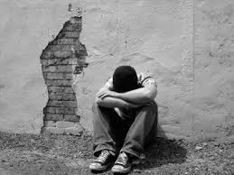
The Disease of Addiction
Notes:
NA uses a simple, experience-oriented disease concept of addiction
We do not qualify our use of the term disease in any medical sense
To us, drug use is only a symptom of the underlying problem, which is the disease of addiction
Some typical behavior patterns of active addiction include
Compulsive, self-centered, obsessive behavior
Living in isolation
Being in denial of drug and living problems
In Narcotics Anonymous we have no pledges to sign, no promises to make to anyone; however, we find that the longer clean, our lives usually improve.

Slide 6
NA Service Structure
Na Groups
Areas
WSO
Region
Notes:
Our service structure in NA is an upside-down pyramid in the autonomous groups, are supported by the greater service structure.
At the top of the pyramid are the autonomous groups of NA: NA groups are local, informal associations of recovering addicts. They are the foundation of the NA service structure. Groups are formed for the primary purpose of carrying the NA message of recovery to the still suffering addict, and all their activities reflect that purpose.
Next the level is an Area: The area service committee is the primary means by which the services of a local NA community are administered.
Regional service committees exist to pool the experience and resources of the areas and groups they serve.
The purpose of the World Service Office is to act as our main service center.

Slide 7
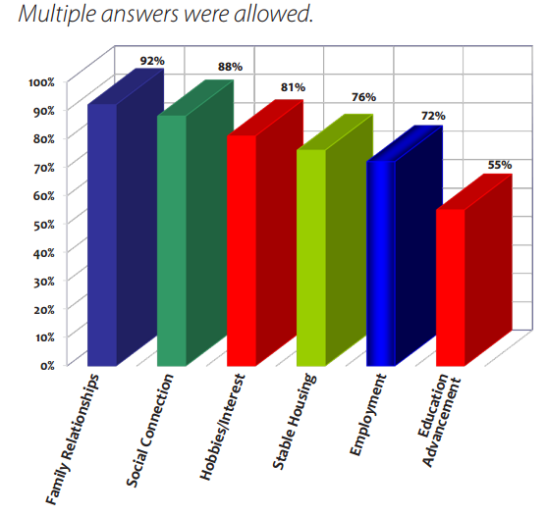
Quality of Life Improvement
Notes:
In our 2013 membership survey, NA members with regular meeting attendance reported overwhelming improvement in family relationships and social connection.
Active addiction is marked by increased isolation and destruction with relationships in particular. It’s clear that recovery in NA helps us to repair the damage in our lives caused by drug addiction. In addition, many member now feel safer in their housing situation, they can hold a job better, and many have gone back to school.

Slide 8

NA Path to Recovery
Support Groups
Focus on Addiction
Addiction as a disease
Uses the 12 steps
Identify as addicts
Sponsorship encouraged
A Higher Power
A spiritual program
Focus on powerlessness
Complete abstinence
Notes:
There are other paths of recovery from addiction and NA is not the end all and be all of recovery; while lots of people get clean and stay clean using other programs; however, we really cannot speak to that, this is what we have in Narcotics Anonymous:
We have support groups: we are recovering addicts who meet regularly to help each other stay clean, we have no professionals.
We focus on recovery from the disease of addiction, not on any specific substance.
Narcotics Anonymous considers addiction as a disease. The physical aspect of our disease is the compulsive use of drugs: the inability to stop using once we have started. The mental aspect of our disease is the obsession, or overpowering desire to use, even when we are destroying our lives. The disease of addiction can manifest itself in a variety of mental obsessions and compulsive actions that have nothing to do with drugs. We sometimes find ourselves obsessed and behaving compulsively over things we may never have had problems with until we stopped using drugs.
NA uses the twelve steps as adapted from Alcoholics Anonymous. The focus of the steps is recovery from addiction not any particular substance. NA also added a focus on the fellowship by adding the word “We” to each of the steps.
Many of us begin the process of surrender when we identify ourselves at an NA meeting with our name and the words, “I am an addict.”
Sponsorship works for the same reason that NA works—because recovering members share common bonds of addiction and recovery and, in many cases, can empathize with each other. A sponsor is simply another addict in recovery who is willing to share his or her journey through the Twelve Steps.
In Step Three, we put our belief in a Higher Power into action, making a decision to turn our will and our lives over to the care of the God of our understanding. The decision we make in Step Three requires that we move away from our self-will.
For the first time in man’s entire history, a simple way has been proving itself in the lives of many addicts. It is available to us all. This is a simple spiritual — not religious — program, known as Narcotics Anonymous.
Even though we didn’t know exactly what would happen, we gathered up our courage and admitted our powerlessness. We gave up the illusion that we could control our using, opening the door to recovery.
This is a program of complete abstinence from all drugs. There is only one requirement for membership, the desire to stop using.
As outlined in In Times of Illness, the choice to take prescribed medication is a personal decision between a member, his or her sponsor, physician, and a higher power. It is a decision many members struggle through. It is not an issue for groups to enforce.
Regarding Drug Replacement Therapies: Because all NA groups are autonomous and because NA’s philosophy of complete abstinence differentiates a drug “used as a replacement” from “prescribed medication for other mental or physical conditions”, addicts who are on prescribed DRT will have different experiences at various NA meetings. The most important thing to remember is that the only requirement for membership is a desire to stop using.

Slide 9
What Narcotics Anonymous is Not
Not about a particular drug or group of drugs – we deal with the disease of addiction
Not the only solution for drug addiction
Not affiliation with any other organizations
Not funded by any third parties
We welcome all addicts to meetings; however, we are not equipped to supervise addicts
We do not monitor the addicts in meetings
We are not governed by a central authority
Notes:
We are not affiliated with any other organizations, we have no initiation fees or dues, no pledges to sign, no promises to make to anyone.
We are not connected with any political, religious or law enforcement groups.
Anyone may join us regardless of age, race, religion, sexual identity, creed, religion, or lack of religion.
Not about any particular drug or group of drugs: To us, a drug is any mind-changing or mood-altering substance
Not the only solution for drug addiction
Not affiliated with any other organizations
Not funded by any third parties
We welcome all addicts to meetings; however, we are not equipped to supervise addicts
We do not monitor the addicts in meetings: Because the only requirement for membership is a desire to stop using, we do not monitor the addicts in meetings
Narcotics Anonymous is not governed by a central authority – our service structure is actually an upside-down pyramid, in which individual groups are served by the greater service structure

Slide 10

Meetings
Notes:
There are over 76 active meetings between St. Paul and Minneapolis and over 400 a week in the state as a whole
The majority of NA meetings in Minnesota are open for the first half and closed for the second half: a closed meeting means we do not allow children or people not seeking recovery
Closed meetings also mean that what is said in that closed meeting (or small group) is not shared with any other person or entity.
There is no central authority of Narcotics Anonymous, each group is autonomous – so long as they do not negatively affect other groups or NA as a whole
There are identity specific meetings (i.e. men only, women only, LGBTQ) however, no addict should be turned away from a meeting and all deal with the same disease: the disease of addiction
No unsafe behavior will be tolerated; however, no policing or supervision occurs at meetings: we are a principle driven, not policy driven organization

Slide 11
Meeting Safety
Narcotics Anonymous is a non-profit organization and are not under any surveillance – no professional security
Trusted servants and other meeting members encourage a safe inviting atmosphere
Calling law enforcement is appropriate when personal safety is at stake.
Notes:
Meetings are generally held in facilities that are not owned and operated by Narcotics Anonymous, this means:
We are responsible for leaving our meeting places cleaner than we found them
Generally speaking, meetings do not hold the insurance for liability, for any damage incurred in a meeting space, the facility does – this means that in order to maintain a good working relationship
Our meeting spaces depend on active cooperation with the facilities in which they are held; however, Narcotics Anonymous is not affiliated with any other outside organizations, including but not limited to the facilities in which our meetings are held

Slide 12

Suggestions
Go to meetings
Get a sponsor
Work steps with that sponsor
Be of service
Notes:
There are few suggestions which most addicts would suggest to newcomers:
Go to meetings (maybe 90 in 90 – 90 meetings in 90 days)
Get a sponsor (of the same sex and over a year of cleantime)
Work steps with that sponsor
Be of service

Slide 13
How We Can Help You
Provide a resource in the community - a soft landing for people finishing treatment programs.
Provide literature and meeting information.
Give Public Information presentations.
Take addicts to meetings.
Start and run meetings in institutions.
Notes:
Our purpose is to be a resource in the community at large and we do this through the following
Provide a resource in the community - a soft landing for people finishing treatment programs.
Provide literature and meeting information.
Give Public Information presentations.
Take addicts to meetings.
Start and run meetings in institutions.

Slide 14
How You Can Help Us
Contributing to a respectful, recovery-oriented atmosphere during meetings
Respecting the autonomy of different meetings
Being supremely respectful of the facilities in which our meetings are held
Creating a safe environment
Communicating clearly with meeting trusted servants
Notes:
How can our community partners assist us?
By contributing to a respectful, recovery-oriented atmosphere during meetings
By respecting the autonomy (and culture) of different meetings
Being supremely respectful of the facilities in which our meetings are held
Creating a safe environment
Communicating clearly with meeting trusted servants

Slide 15

Minnesota Region Resources
Notes:
The Minnesota Region website is a great resource for information for professionals and addicts across the state:
We typically send out two newsletters a month.
One is targeted to professionals, focusing on updated meeting lists and a short local fellowship announcement and a local event.
One is targeted to our membership containing local news, service opportunities, etc.
There are lots of things to do in the Minnesota Region of Narcotics Anonymous; the variety is only limited by the creativity of local addicts. There are dances, speaker jams, campouts, conventions, music festivals, the Regional Unity Games. Although meetings are the backbone of our recovery, we have found that addicts who find fun and fellowship at these events have a higher probability of attaining long-term clean time.

Slide 16
NA in the Community
Recovery Meetings
Helpline (877) 767-7676
Updated meeting lists: monthly newsletter
Meeting Lists & Literature
Bridging the Gap
Sponsorship Behind the Walls
Local Events
Notes:
We have over 400 weekly meetings across the state of Minnesota.
Our 24-hour helpline provides an audio tree of meetings by geography and time of day. The caller can be connected directly to an addict, or leave a message if a helpline volunteer is not available.
We send a monthly newsletter to over 3,000 addresses with fellowship news and links to the updated meeting lists.
Printed meeting lists and literature are available at the table and can ordered from the Upper Midwest Service Office.
Newcomers are matched with an NA volunteer near them who contacts them and meets them at their first NA meeting.
Addicts who are incarcerated can work the steps with a pen pal sponsor through the mail.
We have lots of opportunities for fun and fellowship at dances, picnics, campouts, speaker jams, etc.

Slide 17
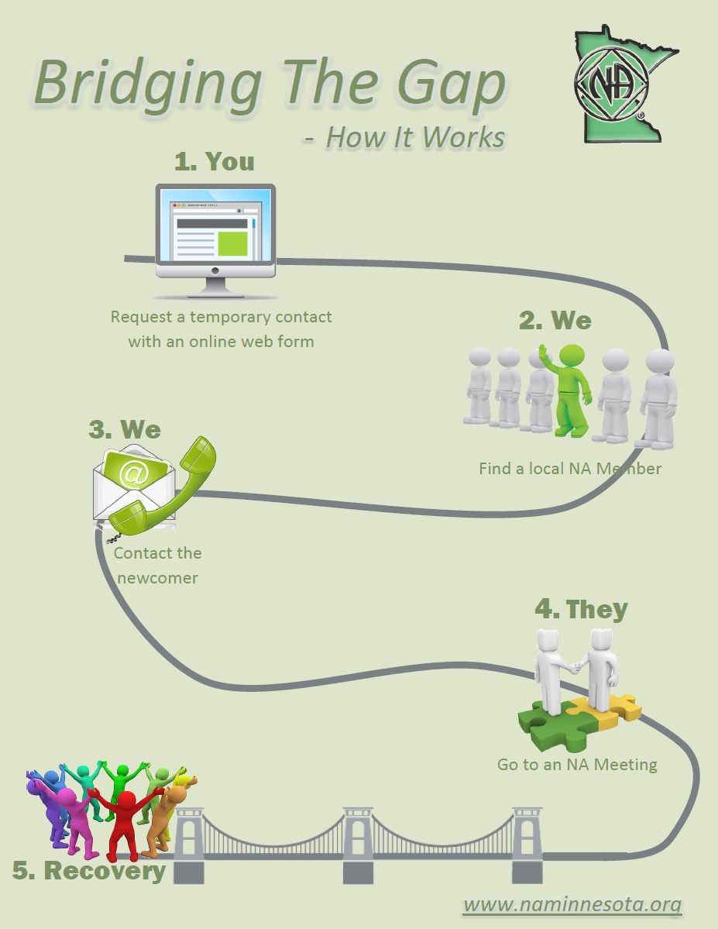
Notes:
The goal of Bridging the Gap is to ease those emotions and help addicts who want what we have to offer find long-term recovery.
A newcomer or a treatment professional can request a temporary contact online.
Our Bridging the Gap team leader finds a local NA member near the newcomer.
The NA member volunteer contacts the newcomer and they agree to meet at an NA meeting.
They go to a meeting, maybe agree to meet 15 minutes ahead of time. The volunteer explains what to expect, gets them a meeting list and some IPs, introduces them around and makes them feel welcome.
They might agree to meet again. They might not. That is the extent of the volunteer’s responsibility. But two things are clear, a newcomer found a way out of active addiction and an NA member’s recovery was enhanced.

Slide 18
Resources
www.naminnesota.org – The Minnesota Region’s website
www.na.org – NA World Services website
info@naminnesota.org – If you have any question, send us an email.

Slide 19

Notes:
Are there any questions, comments, or concerns?
If there any questions you have after this presentation, please feel free to contact us.

