Slide 1
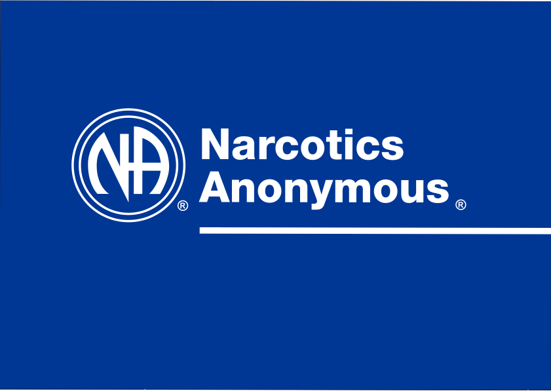
7452995

Slide 2
A Public Information Presentation for Professionals

Slide 3
Our aims today
Describe what Narcotics Anonymous is
Describe what it is not
Explain how to find our meetings and how to get our literature
Outline how we can help you, and how you can help us

Slide 4
Narcotics Anonymous is…
NA is a nonprofit Fellowship or society of men and women for whom drugs had become a major problem.
We are recovering addicts who meet regularly to help each other stay clean.
This is a program of complete abstinence from all drugs.
There is only one requirement for membership, the desire to stop using.

Slide 5
Narcotics Anonymous is…
There are no strings attached to NA.
We are not affiliated with any other organizations, we have no initiation fees or dues, no pledges to sign, no promises to make to anyone.
We are not connected with any political, religious or law enforcement groups.
Anyone may join us regardless of age, race, religion, sexual identity, creed, religion, or lack of religion.

Slide 6
Narcotics Anonymous is…
We are not interested in what or how much you used or who your connections were, what you have done in the past, how much or how little you have, but only in what you want to do about your problem and how we can help.

Slide 7
Narcotics Anonymous is…
The newcomer is the most important person at any meeting, because we can only keep what we have by giving it away.
We have learned from our group experience that those who keep coming to our meetings regularly stay clean.

Slide 8
Narcotics Anonymous is …
Not about any particular drug or group of drugs
  To us, a drug is any mind- or mood-altering substance
Not the only solution for drug addiction
Not a cult or a religion
Not affiliated with any other organization
Not funded by any third parties

Slide 11
Addiction
NA uses a simple, experience-oriented disease concept of addiction
  We do not qualify our use of the term disease in any medical sense
To us, drug use is only a symptom of the underlying problem, which is the disease of addiction
  Some typical behavior patterns of active addiction include
    Compulsive, self-centered, obsessive behavior
    Living in isolation
    Being in denial of drug and living problems

Slide 12
Abstinence and recovery
Narcotics Anonymous encourages its members to observe complete abstinence from all drugs, including alcohol
  It is our experience that complete and continuous abstinence from all drugs is the best foundation for recovery and personal growth
We have found that the therapeutic value of one addict helping another is without parallel
  Meetings, Sponsorship, and Fellowship

Slide 13
The Narcotics Anonymous Group
Meets regularly at a specific time and place; follows the 12 Steps and 12 Traditions of NA
Key components of a meeting:
  Identification of one addict with another, recognition of ourselves in others
  Sharing of personal experience, strength, and hope
  A “sanctuary” where addicts can support one another in fellowship and form new friendships

Slide 14
The Narcotics Anonymous Group
Typical meeting structure
  Readings, Chair, Sharing, Announcements, Key rings, Serenity prayer
The newcomer is the most important person at any meeting
We keep what we have only by giving it away
  Service opportunities in groups help people become involved, eg making tea, handling literature, greeting others
We run Open meetings where non-addicts can attend and observe

Slide 15
The 12 Steps of Narcotic Anonymous
These are tools that help us learn to live and enjoy life without the use of drugs
The 12 Steps of NA teach us honesty, open-mindedness, willingness, acceptance, humility, love, integrity, faith, selfless service and more
Our 12-Step program is based on principles that we can follow in our daily lives
The pace of the program is always up to the individual

Slide 16
The 12 Steps of Narcotic Anonymous
1. We admitted we were powerless over our addiction, that are lives had become unmanageable.
2. We came to believe that a Power greater than ourselves could restore us to sanity.
3. We made a decision to turn our will and our lives over to the care of God as we understood Him.

Slide 17
The 12 Steps of Narcotic Anonymous
4. We made a searching and fearless moral inventory of ourselves.
5. We admitted to God, to ourselves, and to another human being the exact nature of our wrong.
6. We were entirely ready o have God remove all these defects of character.

Slide 18
The 12 Steps of Narcotic Anonymous
7. We humbly asked Him to remove our shortcomings.
8. We made a list of all persons we had harmed and became willing to make amends to them all.
9. We made direct amends to such people whenever possible, except when to do so would injure them or others.

Slide 19
The 12 Steps of Narcotic Anonymous
10. We continued to take personal inventory and when wrong promptly admitted it.
11. We sought through prayer and meditation to improve our conscious contact wit od as we understood Him, praying only for knowledge of His will for us and the power to carry that out.
12. Having had a spiritual awakening as a result of these steps, we tried to carry this message to addicts, and to practice these principles in all our affairs.

Slide 20
Spirituality
Narcotics Anonymous is a spiritual, non-religious, program and encourages each member to cultivate an individual understanding of a Higher Power, whether or not religious.

Slide 21
Sponsorship
The essence of NA is the therapeutic value of one addict helping another.
Sponsorship is a very practical way of achieving this.
Members are free to choose a sponsor (or not to, though it is suggested they do).
Sponsors act as mentors or guides, helping sponsees to work through the 12 Steps of Narcotics Anonymous.

Slide 22
Some aspects of recovery
The honest admission of being an addict.
Finding hope and a motivating message of a better future – that people can and do overcome the internal and external challenges, barriers, and obstacles that confront them.
Coming to a better understanding of ourselves, changing our old behaviors, removing defects of character, making amends for past wrongs.

Slide 23
Life after drugs
We develop new interests.
We practice spiritual principles in our lives.
We develop freedom from self-obsession.
We gain self-respect as well as respect for others.
We get together and develop new friendships:
  Conventions
  Learning Days
  Speaker Jams
  Spiritual Retreats
  Picnics, bowling, softball, hikes, etc.

Slide 24
The Service Structure
The Group serves the addict seeking Recovery.
The Area serves the Group.
The Region serves the Area.
The World serves the Region.

Slide 25
The Service Structure
Hospitals & Institutions serves the addict unable to attend regular meetings.
Public Relations serves the community:
  Helpline: (952) 939-3939
  Meeting Information Line: (877) 767-7676
  Website: www.naminnesota.org
  Literature: www.na.org

Slide 26
How we can help you
Provide a resource in the community - a soft landing for people finishing treatment programs.
Provide literature and meeting information.
Give Public Information presentations.
Take you to a meeting.
Start and run meetings in institutions.
Advise on how to start public meetings.

